Slide 1

Building & Mining Knowledge Graphs
(KEN4256)
Lecture 2: FAIR Knowledge Graphs, provenance and other metadata
Michel Dumontier and Kody Moodley

Slide 2
An increasing number of discoveries are made using other people’s data

Slide 3
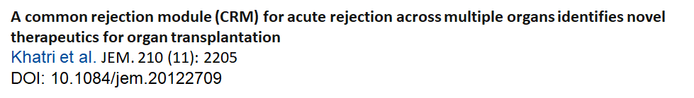
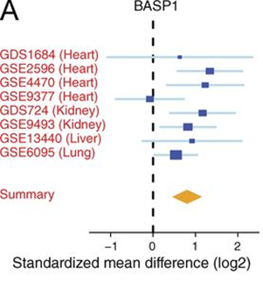
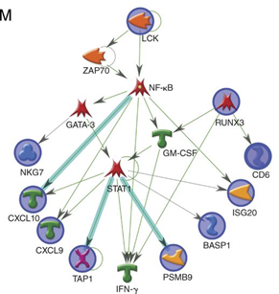
Main Findings:
1.CRM genes predicted future injury to a graft
2.Mice treated with drugs against the CRM genes extended graft survival
Key Observations:
1. Meta-analysis offers a more reliable estimate of the magnitude of the effect
2. Other’s people data can be used to generate and test new hypotheses

Slide 4
However, significant effort is needed to find the right information, make sense of it, clarify your rights and responsibilities, and ultimately use them for a new purpose

Slide 5
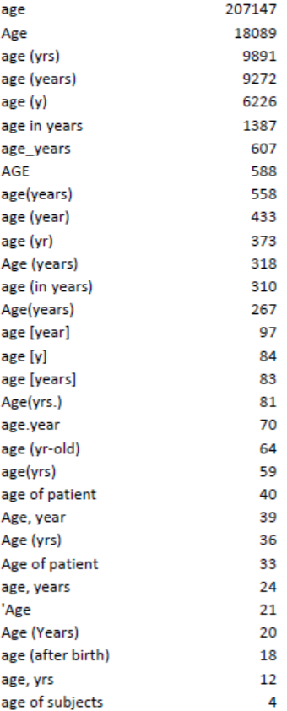

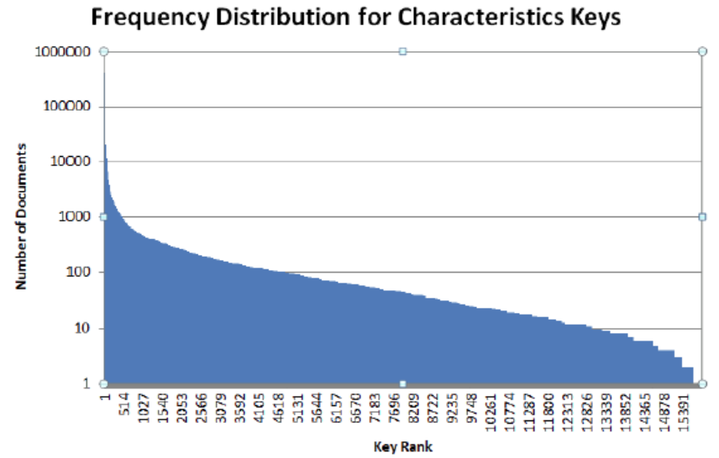
Poor quality (meta)data doesn’t help matters

Slide 6
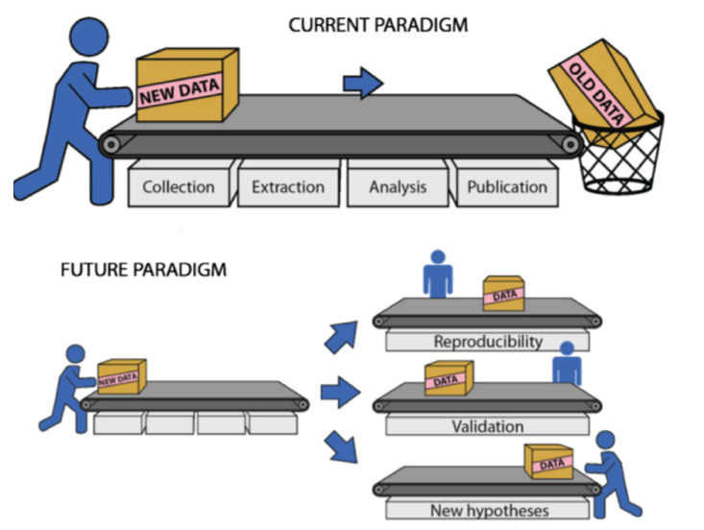
Lambin et al. Radiother Oncol. 2013. 109(1):159-64. doi: 10.1016/j.radonc.2013.07.007

Slide 7
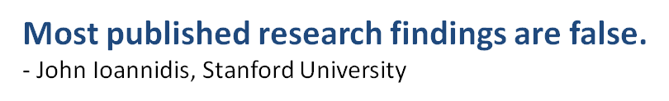
Reproducibility of landmark studies is shockingly low:
39% (39/100) in psychology (doi:10.1038/nature.2015.17433) 21% (14/67) in pharmacology (doi:10.1038/nrd3439-c1) 11% (6/53) in cancer (doi:10.1038/483531a)

Slide 8
We must form a new social contract, supported by legal and technological infrastructure, that facilitates the discovery and reuse of digital resources
for people and machines

Slide 9
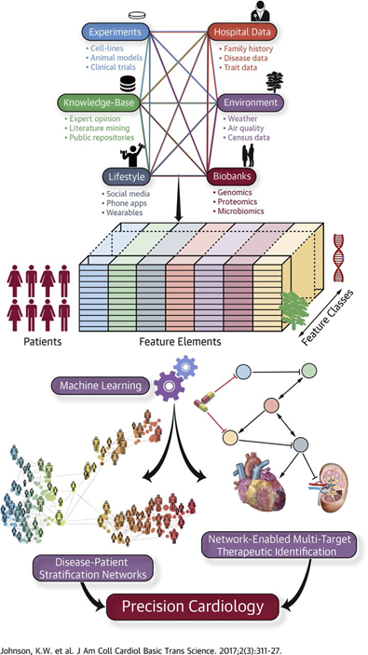
Why machines?
Big Data for Medicine
Multiple sources of heterogeneous data, including experimental evidence, bioinformatics databases, lifestyle measurements, electronic health records, environmental influences, and biobank findings, can be combined using machine learning algorithms to identify causal disease networks, stratify patients, and predict more efficacious therapies.

Slide 10
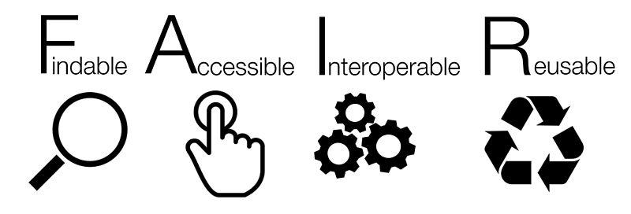

Slide 11
An international, bottom-up paradigm for the discovery and reuse of digital content
by and for people and machines

Slide 12
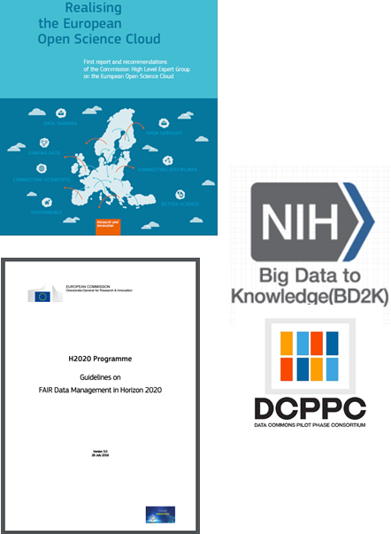
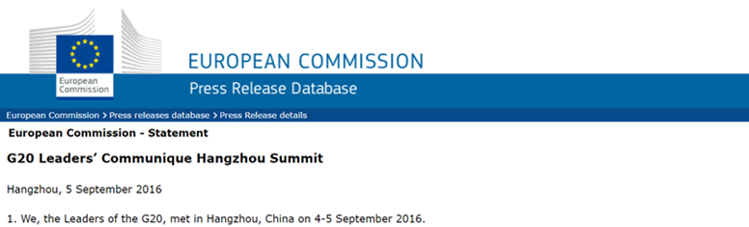
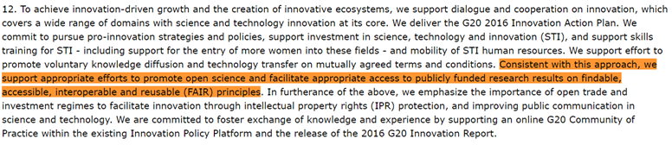

Slide 13
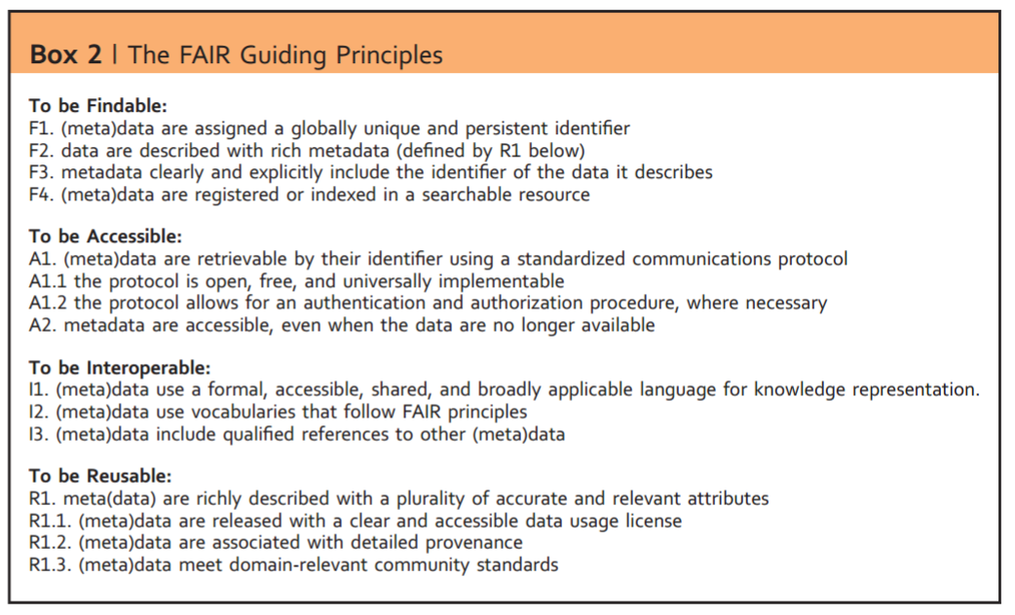
http://www.nature.com/articles/sdata201618
4 Principles (F,A,I,R) and 15 sub-principles.

Slide 14
FAIR in a nutshell
FAIR aims to create social and economic impact by facilitating the discovery and reuse of digital resources through a set of basic requirements:
unique identifiers to retrieve all forms of digital content and knowledge
high quality meta(data) to enhance discovery of digital resources
pragmatic community standards to align representations and simplify reuse
use of common vocabularies to create shared meaning and facilitate search
detailed provenance to provide context and enable reproducibility
social and technological commitments to realize reliable access
simpler terms of use to clarify expectations and intensify innovation

Slide 15
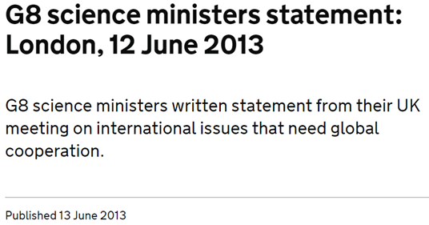
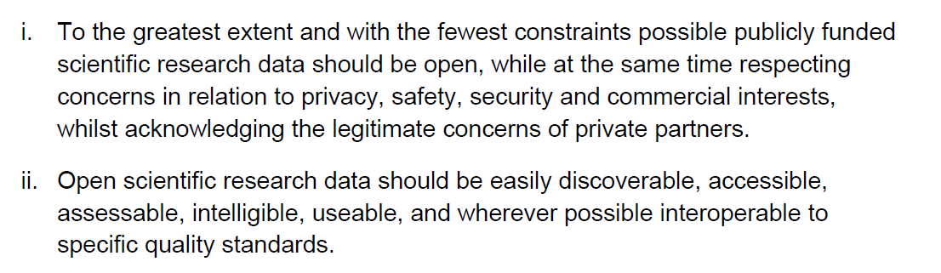
FAIR does not imply Open.
Open as possible
closed as is necessary

Slide 16
Why Go FAIR?
Make it easier for me to use my data for a new purpose
Make it easier for other people to find and use my data, and to understand what I expect of them in return
Make it easier/possible for people to verify my work
Ensure that the data are available in the future, especially after I stopped caring about them
Satisfy expectations around data management from institution, funding agency, journal, my peers

Slide 17
F1: (meta) data are assigned globally unique and persistent identifiers
The uniqueness of an identifier is a necessary condition to unambiguously refer that resource, and that resource alone. Otherwise, an identifier shared by multiple resources will confound efforts to describe that resource, or to use the identifier to retrieve it.
A persistent identifier is one where once assigned, an identifier denotes the same referent indefinitely, and is never re-assigned to another entity. This ensures that the identifier is can be used in the future to specifically find the content that it refers to.

Slide 18
What’s in a name?
3336842 no context; could refer to anything gi:3336842 provider, resource identifier, but no guarantee of global uniqueness on the prefix doi:10.1038/sdata.2016.18 scheme, provider, and unique provider-assigned identifier doi:10.4121/uuid:5146dd06-98e4-426c-9ae5-dc8fa65c549f scheme, provider, and autogenerated “unique” identifier orcid:0000-0001-8888-635X scheme, unique identifier https://orcid.org/0000-0001-8888-635X scheme, provider, resource identifier, resolvable https://raw.githubusercontent.com/FAIRDataInitiative/FAIR-principles/master/fair.trustyuri.trig#np.RA4FsMT1XSZMh-JgNmAuOVQ3qyTzkaMldT_KxR1HSdoUA scheme, provider, resource identifier, resolvable, independently veriable

Slide 19


FAIR metrics
provide a URL to a document that describes the identifier scheme. FAIRsharing lists different identifier schemes https://fairsharing.org/standards/?q=&selected_facets=type_exact:identifier%20schema
provide a URL to a document that details the identifier management plan. This includes aspects related to what happens in the event of IT disaster, backwards compatiblity in the event of changes in identifier scheme, and the transfer of authority.

Slide 20
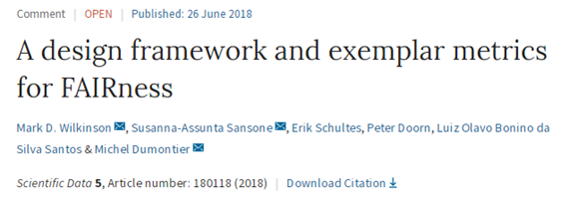
http://fairmetrics.org
14 universal metrics covering each of the FAIR sub-principles. The metrics don’t dictate any particular standards. They simply demand evidence (using protocols of the Web) that you have met community expectations.
Digital resource providers must provide at least one web-accessible document with machine-readable metadata (FM-F2, FM-F3), resource management plan (FM-A2), and any additional authorization procedures (FM-A1.2).
They must use publically registered: identifier schemes (FM-F1A), (secure) access protocols (FM-A1.1), knowledge representation languages (FM-I1), licenses (FM-R1.1), provenance specifications (FM-R1.2), and community standards (FM-R1.3)
They must evidence that their resource can be located in search results (FM-F4), that it provides links to other (FAIR) resources (FM-I3; FM-I2), and it validates against community standards (FM-R1.3)

Slide 21
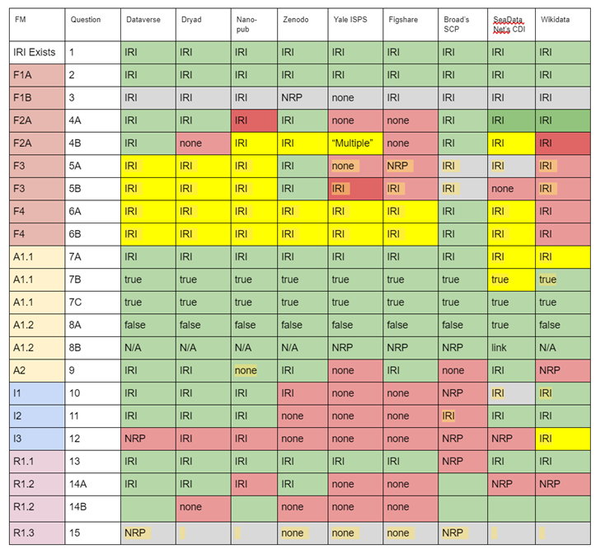
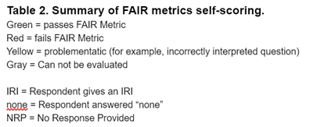

Slide 22
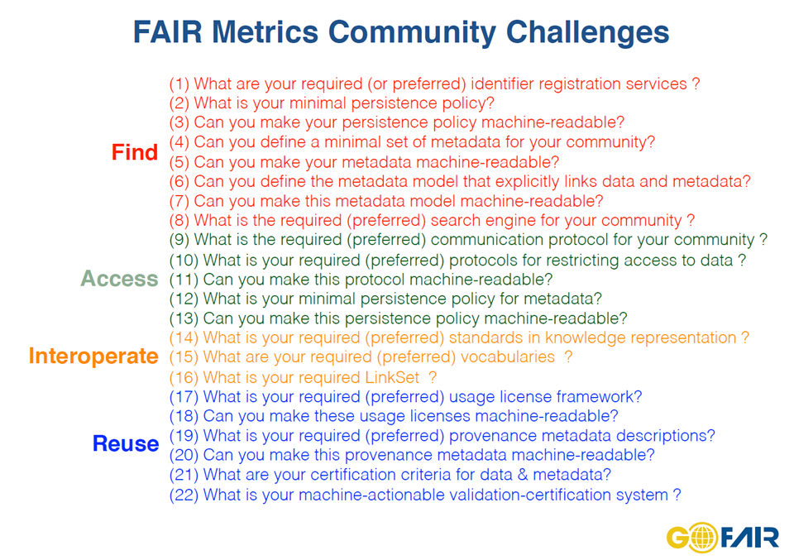

Slide 23
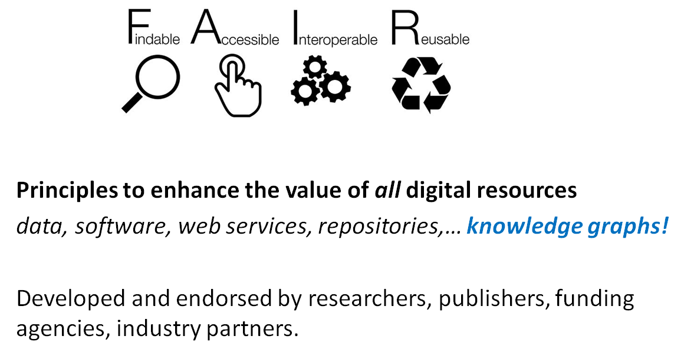

Slide 24
FAIR for Knowledge Graphs
Build your knowledge graph using existing standards
Assign a unique identifier to every entity (types, relations, instances)
Represent context and provenance
Format the data using a data standard (e.g. RDF, nanopublications)
Create high quality metadata to document your KG
use common metadata dictionaries and formats
specify KG specific metadata
Make your KG available to others
version your KG, and publish the data and metadata to an archive
Create KG access points via APIs

Slide 25
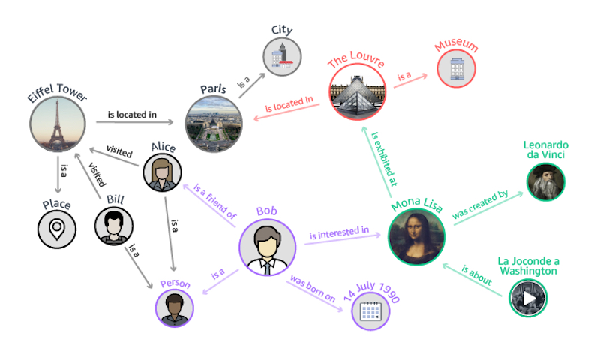
entity
relation
context:
when is the relation valid?
how did it come into existence?
who or what was involved?
statement provenance:
when was the statement made?
who made the statement?
how was it made?
where was it reported?
what are the terms of use?
instance
type
attribute

Slide 26
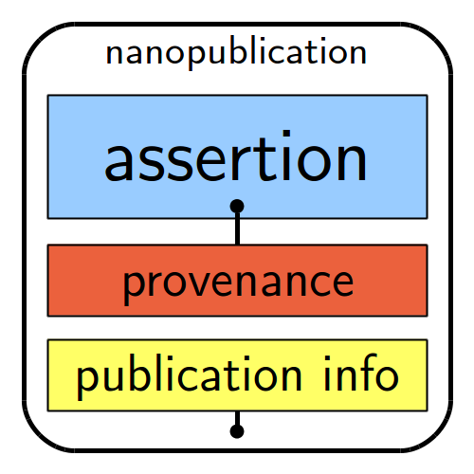
Nanopublication
A nanopublication has three basic elements: 1) The Assertion: An assertion minimally expresses a relationship between two entities.
2) The Provenance: This is metadata providing some context about the assertion. Provenance means, ‘how this came to be’ and includes the methods that were used to generate the assertion along with attributional metadata such as authors, institutions, time-stamps, grants, links to DOIs, URLs about the assertion.
3) The Publication Information: This is metadata about the nanopublication as a digital object.
:head { ex:pub1 a np:Nanopublication . ex:pub1 np:hasAssertion :assertion . ex:pub1 np:hasProvenance :provenance . ex:pub1 np:hasPublicationInfo :pubInfo . }
http://nanopub.org

Slide 27
The assertion graph of the nanopublication contains an assertion that is comprised of one or more RDF triples (subject-predicate-object tuples).
The publication information graph contains one or more RDF triples that offer provenance information regarding the nanopublication itself.
:assertion { ex:trastuzumab ex:is-indicated-for ex:breast-cancer . }
The provenance graph of the nanopublication contains one or more RDF triples that provide information about the assertion.
:provenance { :assertion prov:generatedAtTime "2012-02-03T14:38:00Z"^^xsd:dateTime . :assertion prov:wasDerivedFrom :experiment . :assertion prov:wasAttributedTo :experimentScientist . }
when
how
who
:pubInfo { ex:pub1 prov:wasAttributedTo ex:paul . ex:pub1 prov:generatedAtTime "2012-10-26T12:45:00Z"^^xsd:dateTime . }

Slide 28
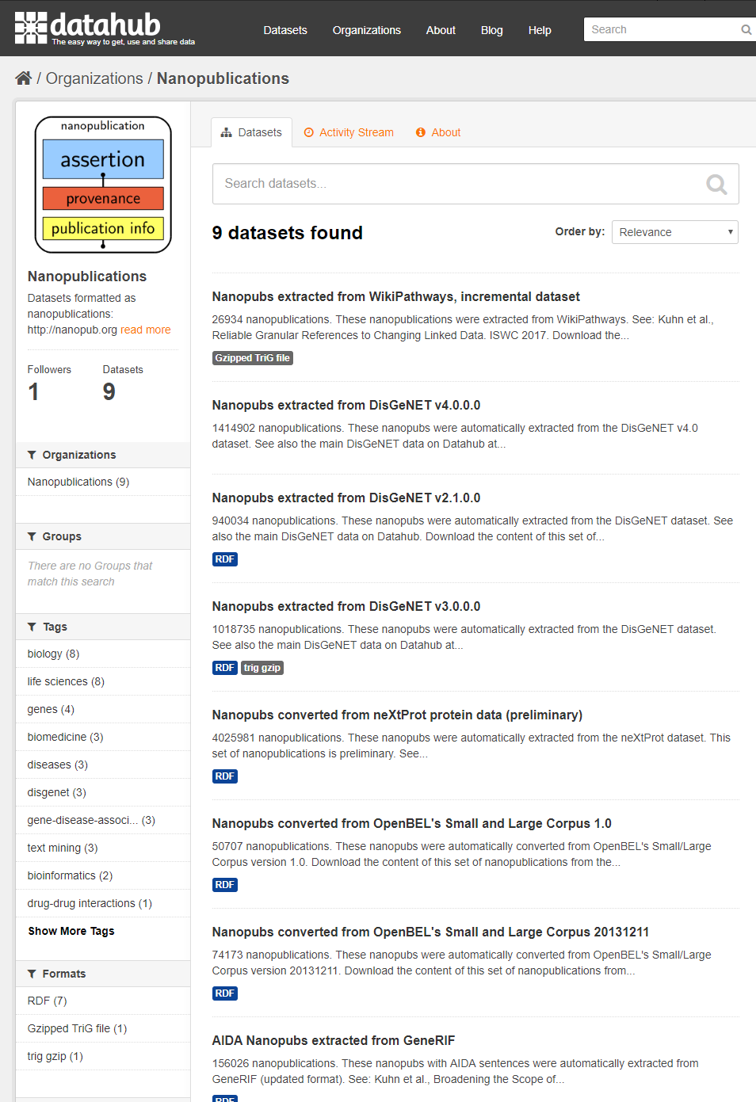
The datahub.io is a repository for datasets. Some of the nanopublications are registered at the previous version of the site:
https://old.datahub.io/organization/nanopublications

Slide 29
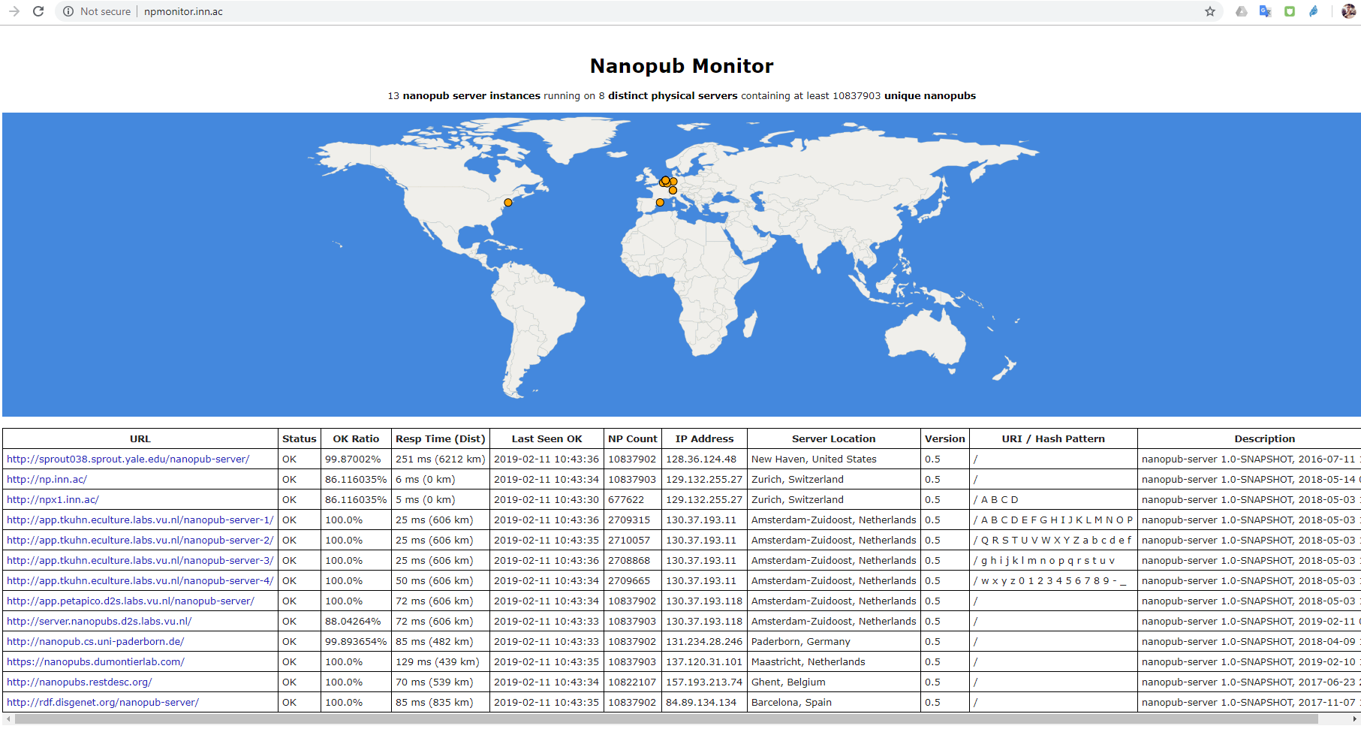

Slide 30
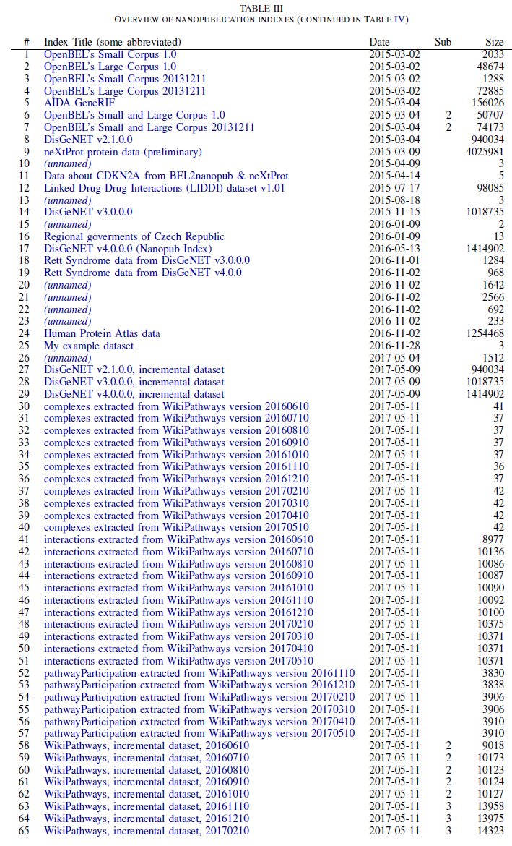
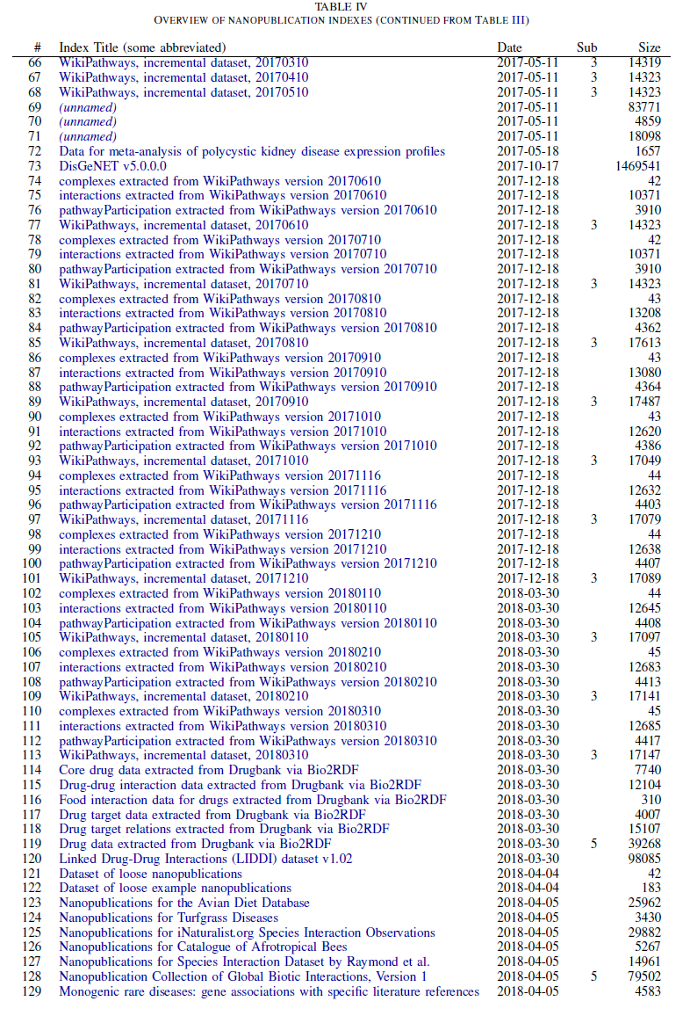

Slide 31
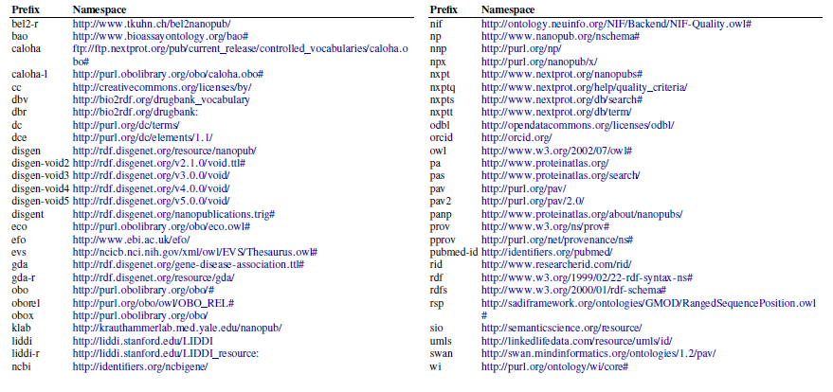

Slide 32
Which metadata might we use to describe a knowledge graph?

Slide 33
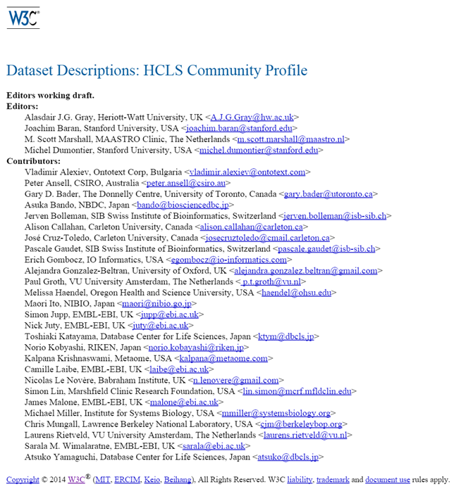
A guide to describe datasets with RDF vocabularies
Identifiers
Descriptors
Versioning
Attribution
Provenance
Content summarization
Mandatory, recommended, optional descriptors Reference editor and validation

Slide 34
Basic Description
Identifiers
Title
Description
Homepage
License
Language
Keywords
Concepts and vocabularies used
Standards
Reference Documentation/Publication
Format
Download URL
Landing page
SPARQL endpoint

Slide 35
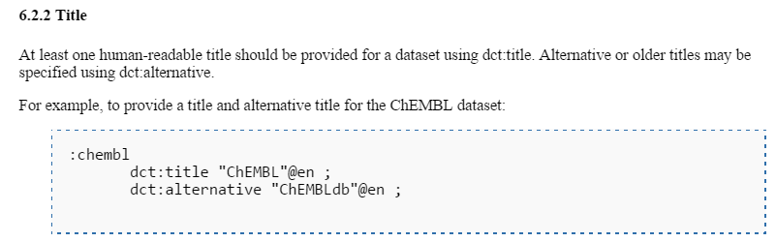
Metadata element, description, and example of use

Slide 36
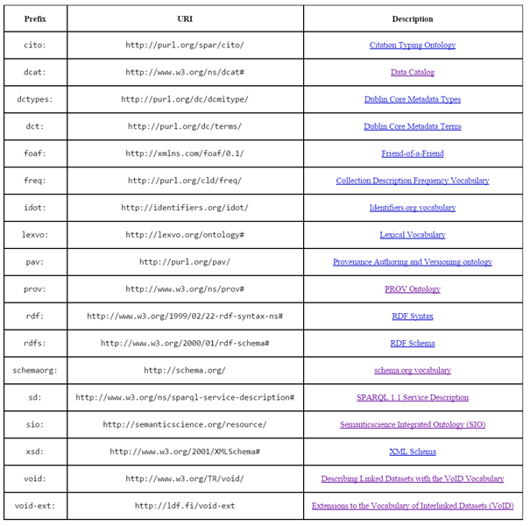

Slide 37
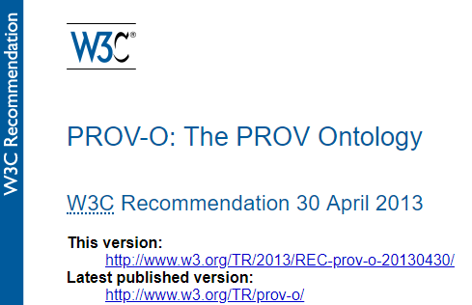

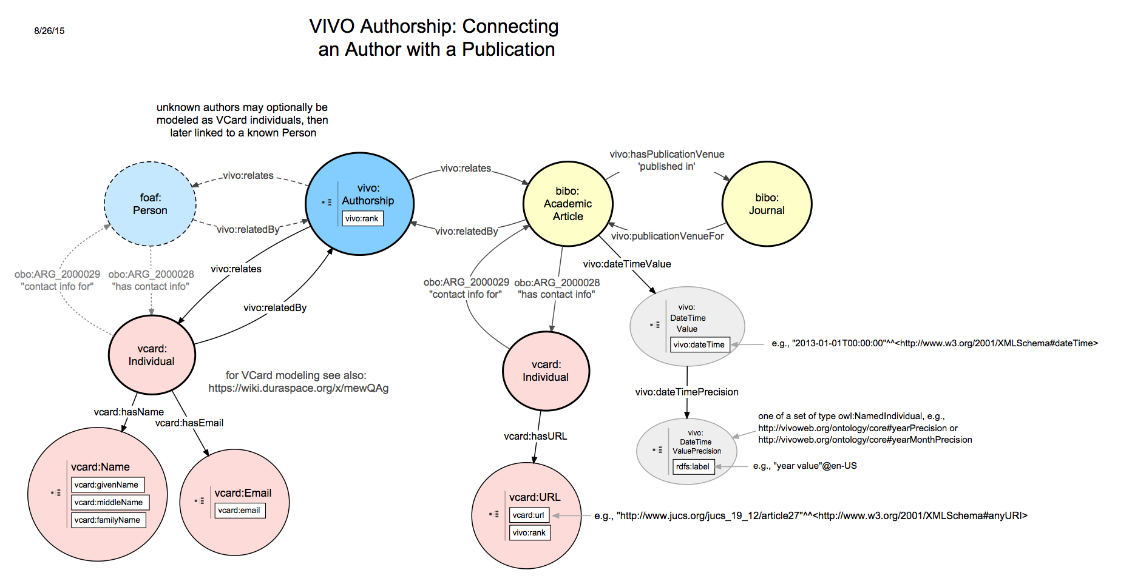
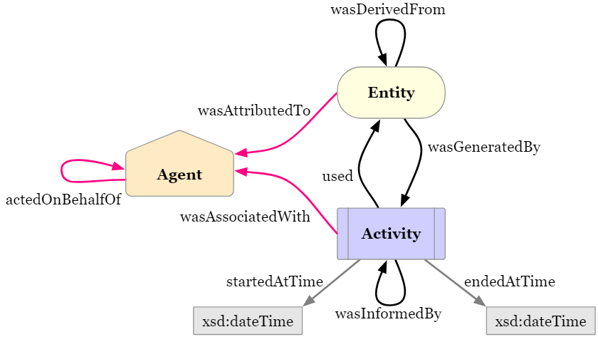

Slide 38
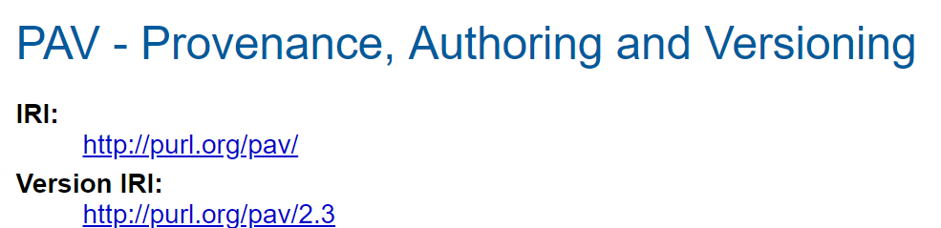
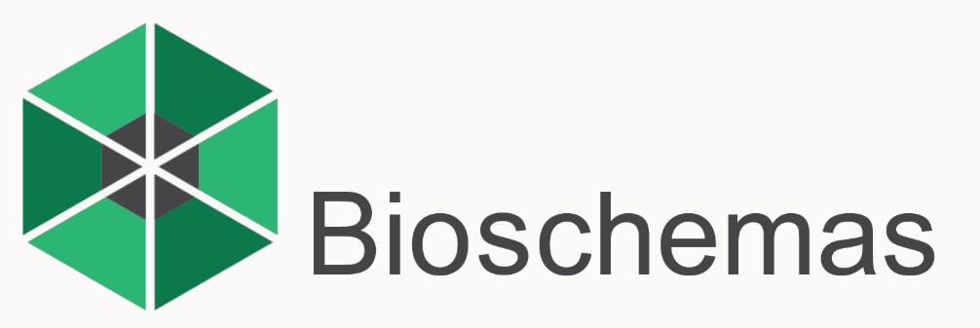
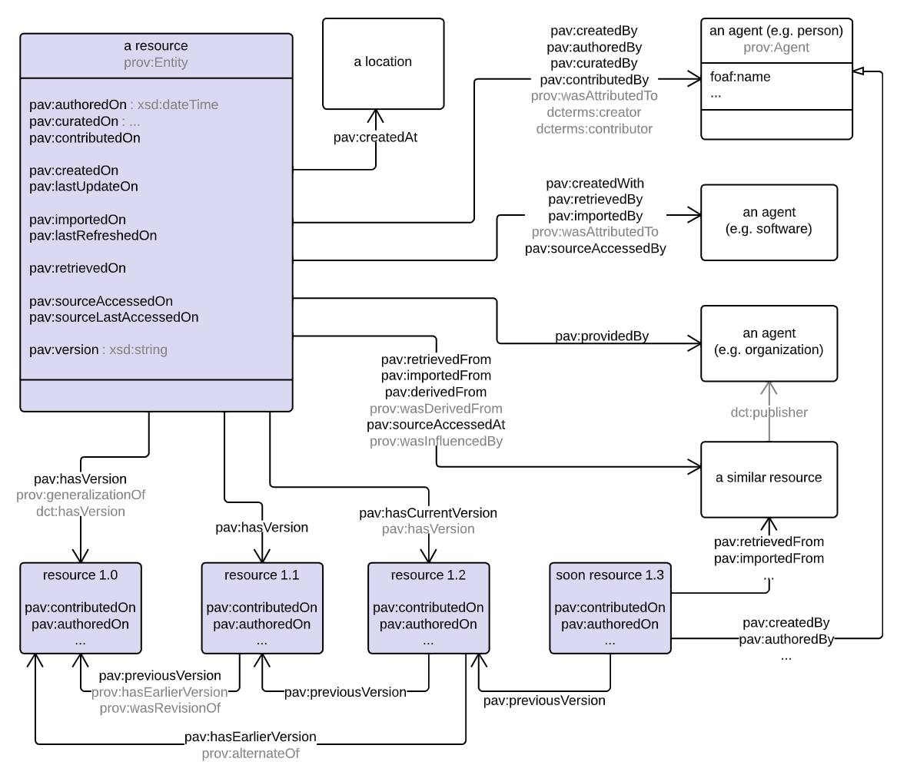
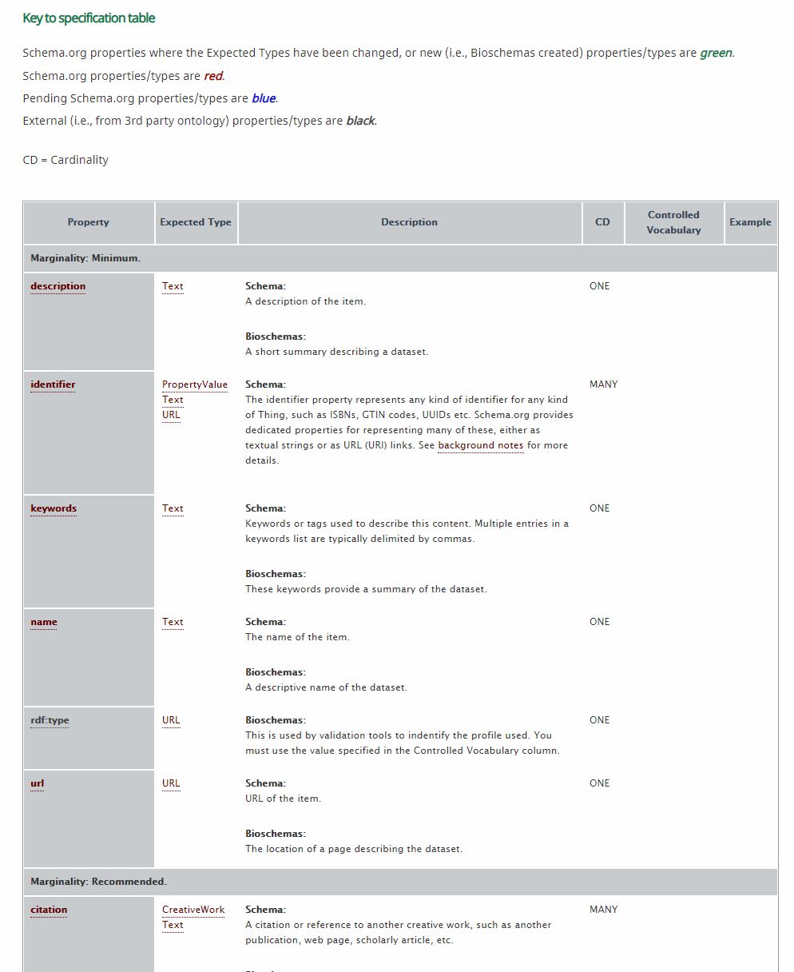
http://bioschemas.org

Slide 39
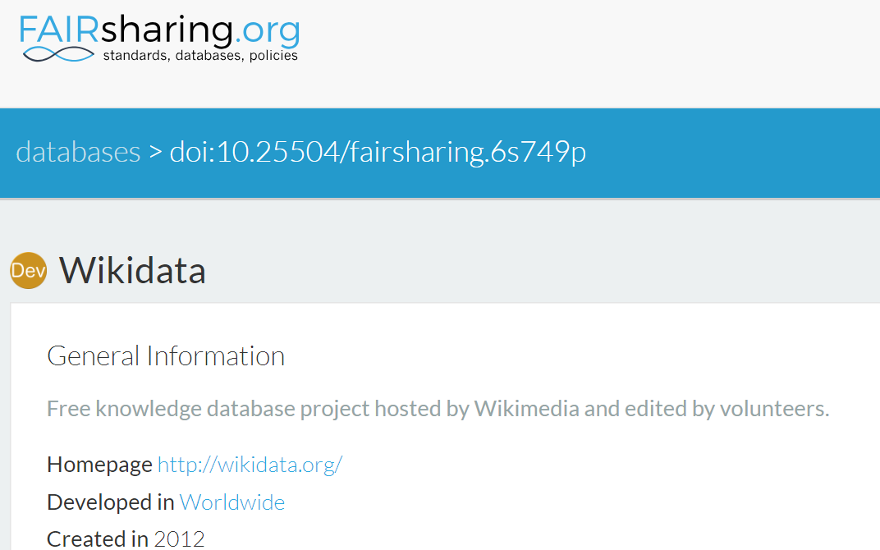
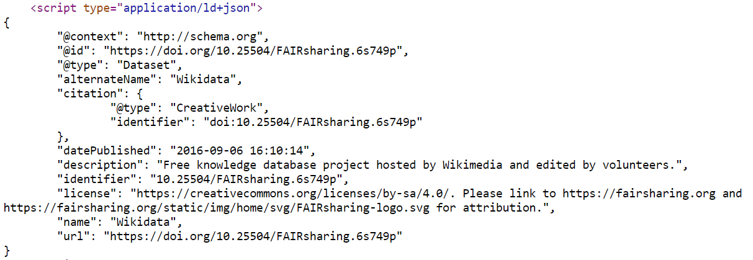
FAIRsharing is a repository of standards and databases. It exposes resource metadata using schema.org

Slide 40
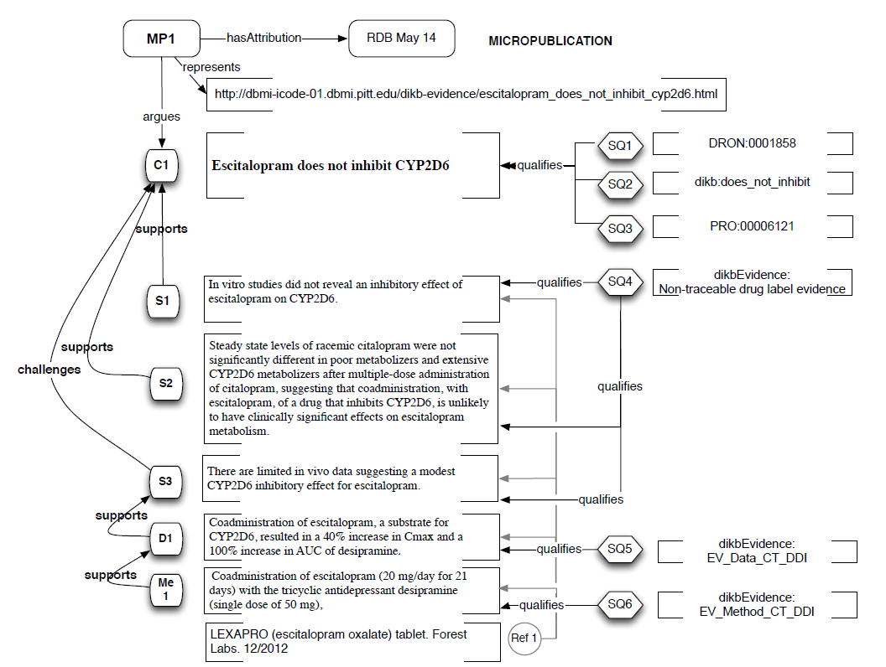
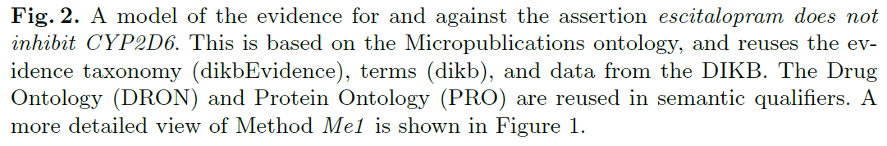
Micropublication model
To create argumentation graphs from text.
Uses the micropublication ontology and the open annotation data model
Tim Clark

Slide 41
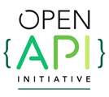
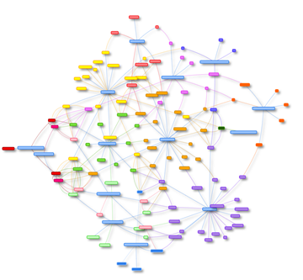
smartAPI
http://smart-api.info
Goal is to maximize the FAIRness of web-based Application Programming Interfaces (APIs).
Rich metadata is essential to properly describe your API so that it becomes discoverable, connected, and reusable.
Extends the openAPI specification with new API metadata elements and value sets for documenting APIs.
Descriptions can be automatically analyzed to generate interfaces and executable programs
http://biothings.io/explorer/
Zaveri A. et al. (2017) smartAPI: Towards a More Intelligent Network of Web APIs. In The Semantic Web. ESWC 2017. Lecture Notes in Computer Science, vol 10250. Springer, Cham

Slide 42
FAIR Resources
Dutch Techcenter for the Life Sciences https://www.dtls.nl/fair-data/
FAIR principles explained
FAIR tooling
FAIR data training
GO FAIR - https://www.go-fair.org/ FAIRsharing - http://fairsharing.org
FAIR metrics - http://fairmetrics.org

